Slide 1
DECRESE & cONQUER

Slide 2
Overview
Insertion Sort
Depth First Search
Breadth First Search
Topological sorting

Slide 3
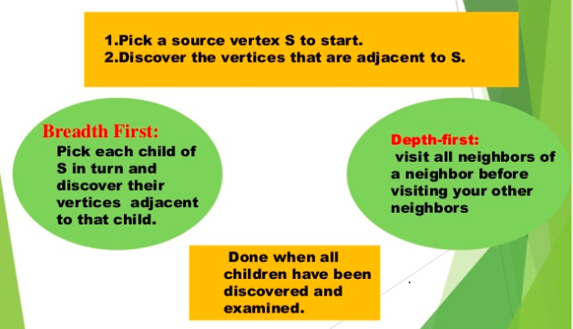
BFS v/S DFS

Slide 4
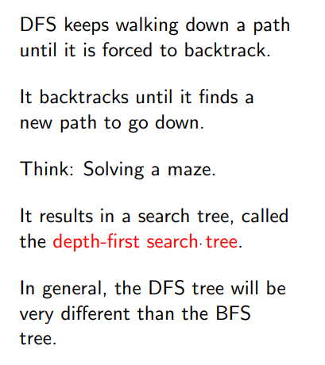
Depth First Search

Slide 5
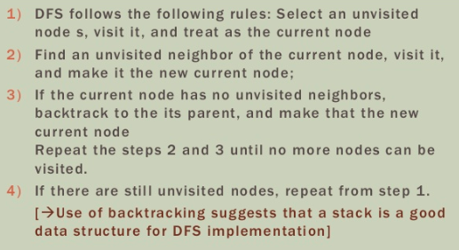
DFS - Methodology

Slide 6
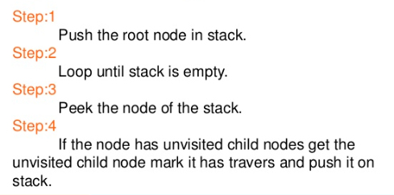
DFS - Algorithm

Slide 7
DFS Search Tree
A
B
C
S
G
S
D
E
F
A
D
Stack = {A,D}

Slide 8
DFS Search Tree
A
B
C
S
G
S
D
E
F
A
D
B
D
Stack = {B,D,D}

Slide 9
DFS Search Tree
A
B
C
S
G
S
D
E
F
A
D
B
D
Stack = {C,E,D,D}
C
E

Slide 10
DFS Search Tree
A
B
C
S
G
S
D
E
F
A
D
B
D
Stack = {D,F,D,D}
C
E
D
F

Slide 11
DFS Search Tree
A
B
C
S
G
S
D
E
F
A
D
B
D
Stack = {G,D,D}
C
E
D
F
G

Slide 12
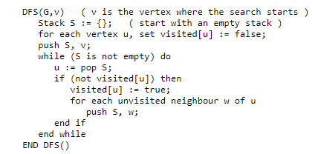
Non recursive DFS

Slide 13
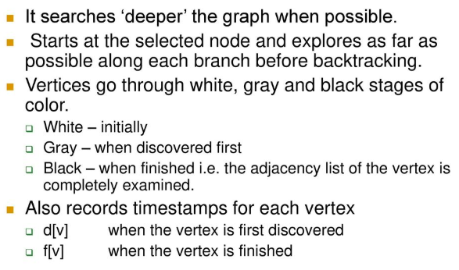

Slide 14
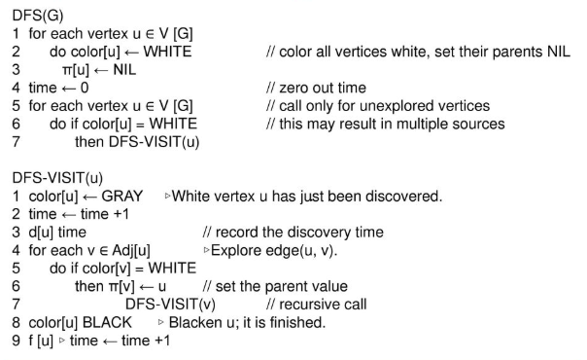

Slide 15
Visualization
https://www.cs.usfca.edu/~galles/visualization/DFS.html

Slide 16
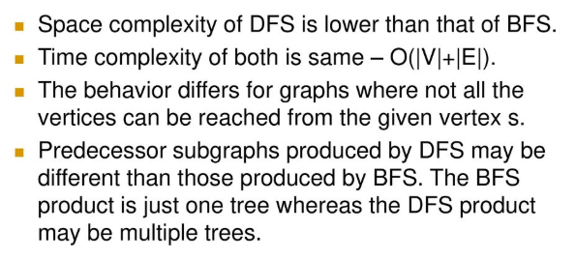
Comparison BFS v/s DFS

Slide 17
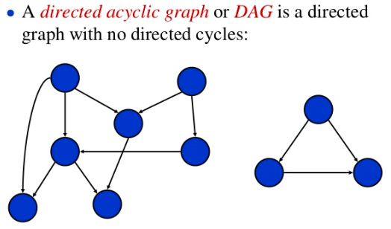
Directed Acyclic Graph

Slide 18
DAG
DAG is a finite directed graph with no directed cycles.
That is, it consists of finitely many vertices and edges (also called arcs), with each edge directed from one vertex to another, such that there is no way to start at any vertex v and follow a consistently-directed sequence of edges that eventually loops back to v again.
A directed graph is acyclic if and only if it has a topological ordering.

Slide 19
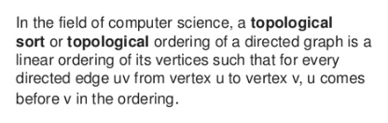
Topological Sorting

Slide 20
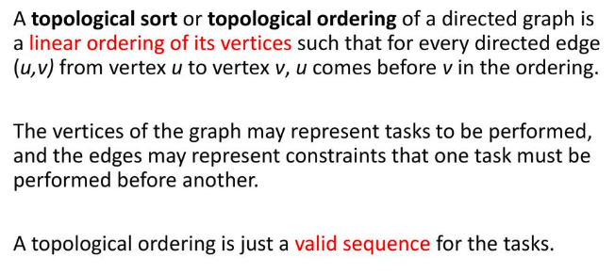

Slide 21
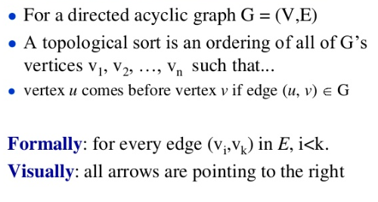

Slide 22
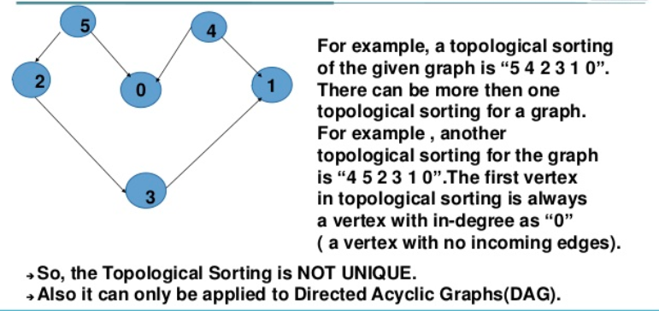

Slide 23
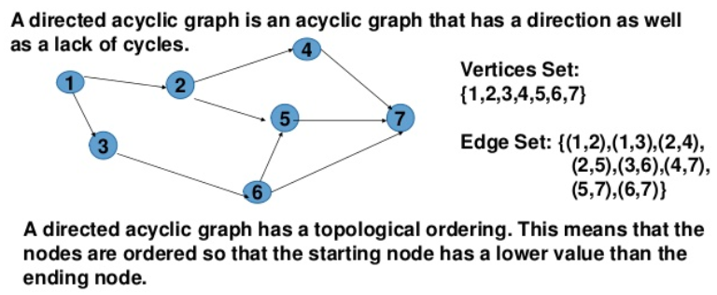

Slide 24
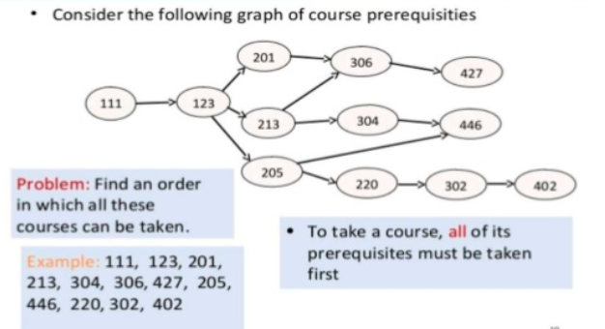

Slide 25
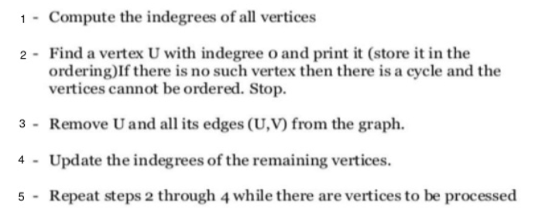
Topological sorting - Algorithm

Slide 26
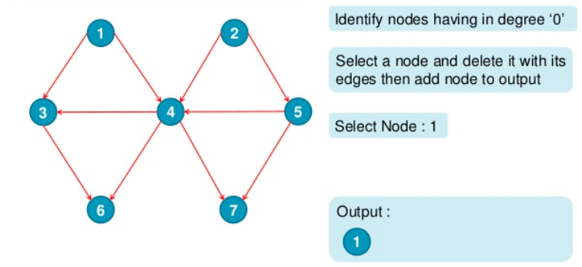
Topological Sorting - Example

Slide 27
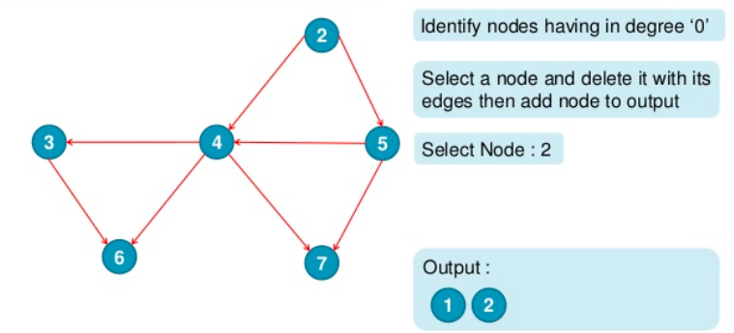

Slide 28
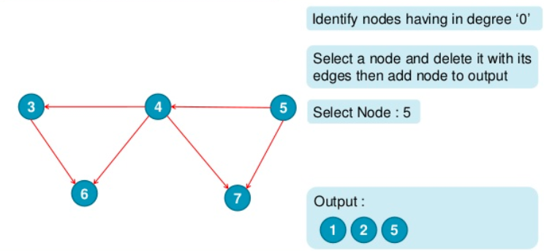

Slide 29
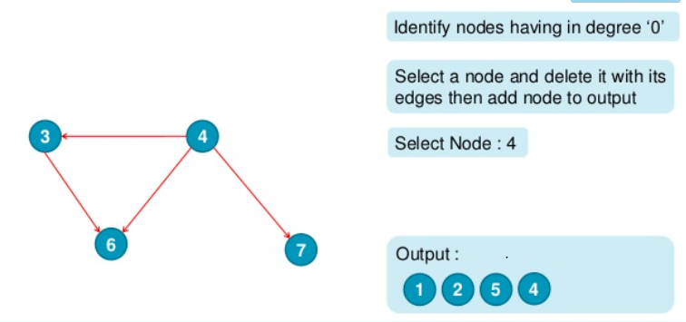

Slide 30
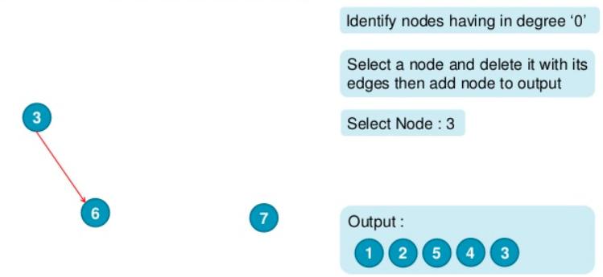

Slide 31
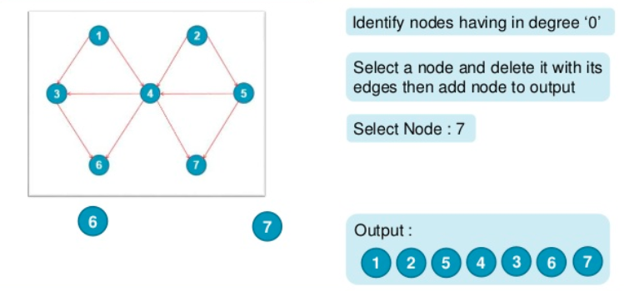

Slide 32
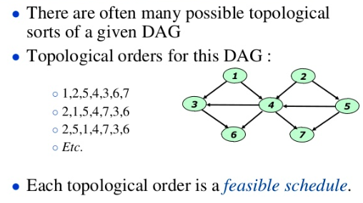

Slide 33
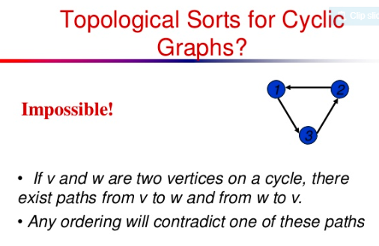

Slide 34

Topological Sorting- Applications

Slide 35
